Slide 1
Database Systems
Introduction to Database Systems
吴汉瑞 , 副教授 Hanrui Wu, Associated Professor
Email: wuhanrui@jnu.edu.cn
Research area: machine learning, artificial intelligence
Contact me if you are interested in research or would like to be my postgraduate

Slide 2
Q群：760882647

Slide 3
Before we start
Talk about 1 minute about yourself: your background, main accomplishments, why you joined JNU, your interests, why you are taking CS, plans for and after graduation

Slide 4

Agenda
1 Course Introduction
2 Databases and Database Users
3 Database System Concepts and Architecture
4 Summary and Conclusion

Slide 5

Course Objectives
The goal is to teach students the fundamental concepts underlying database system design, including not only the design of applications using databases, but also covering the fundamental implementation techniques used in database systems.
Gain understanding of fundamental concepts of state-of-the-art Databases (more precisely called: Database Management Systems)
Get to know some of the tools used in the design and implementations of databases
Know enough so that it is possible to read/skim a database system manual and
Start designing and implementing small data bases
Start managing and interacting with existing small to large databases
Experiment and practice with industry leading vendor solutions:
PostgreSQL, MySQL for writing relational queries
Navicat for PostgreSQL or Navicat for MySQL
Write database-based applications

Slide 6
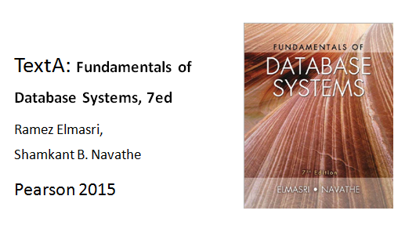
Text Book A

Slide 7
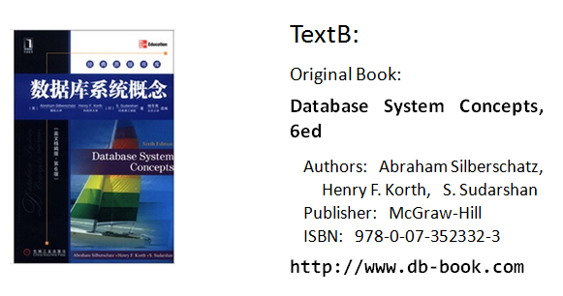
Text Book B

Slide 8
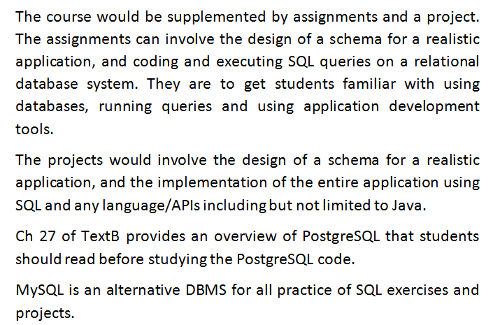
Assignments/Projects

Slide 9
Evaluation
Attendance, Exercises (40%)
Projects (60%)

Slide 10
Main Contents
Introduction to Database Systems
Entity-Relationship Model
SQL: DDL, DML, Introduction, Intermediate, Advanced
Relational Model
Normalization: Schema Refinement
Relational Algebra
Storage, Files and Buffer Management
Indexing and Sorting
Relational Operators
Query Optimizations
Transactions Management
Additional selected topics (optional)

Slide 11
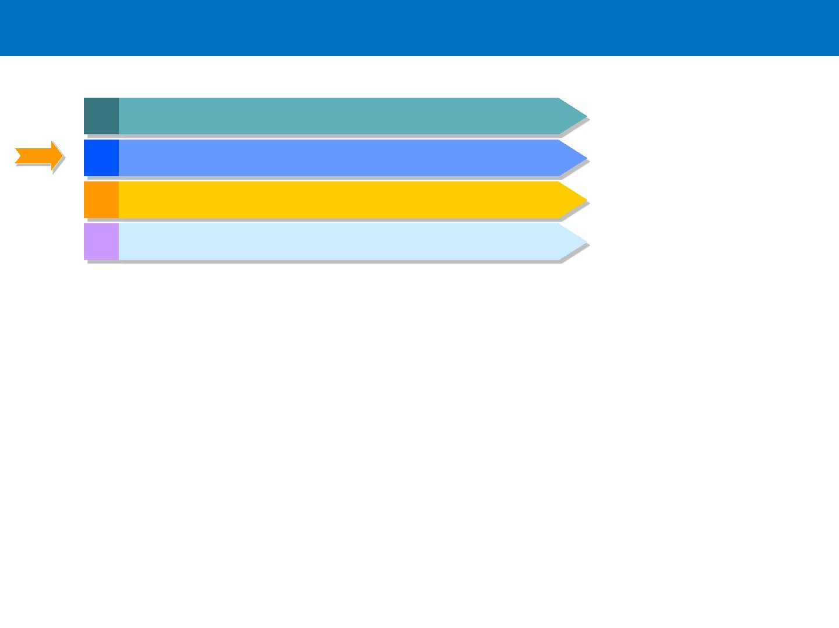
Agenda
1 Course Introduction
2 Databases and Database Users
3 Database System Concepts and Architecture
4 Summary and Conclusion

Slide 12
Section Outline
. Types of Databases and Database Applications
. Basic Definitions
. Typical DBMS Functionality
. Example of a Database (UNIVERSITY)
. Main Characteristics of the Database Approach
. Types of Database Users
. Advantages of Using the Database Approach

Slide 13
Types of Databases and Database Applications
. Traditional database applications
. Store textual or numeric information
. More recent applications:
» Object Databases (ODMSs)
» Graph Databases
» Multimedia databases
. Store images, audio clips, and video streams digitally
» Geographic information systems (GIS)
. Store and analyze maps, weather data, and satellite images
» Biological and Genome Databases
» Data warehouses and online analytical processing (OLAP) systems
. Extract and analyze useful business information from very large databases
. Support decision making
» Mobile databases
» Real-time and active databases
. Control industrial and manufacturing processes
. Business Intelligence Platforms
. Unstructured vs. Structured Databases
» Big Data

Slide 14
Basic Definitions
. Database
. Collection of related data
. Logically coherent collection of data with inherent meaning
. Built for a specific purpose
. Data
. Known facts that can be recorded and have an implicit meaning
. Mini-world or Universe of Discourse (UoD)
. Represents some aspect of the real world about which data is stored in a database
(e.g., student grades and transcripts at a university)
. Example of a large commercial database
. Amazon.com
. Database management system (DBMS)
» A software package/ system to facilitate the creation and maintenance of a
computerized database
. Database system
. The DBMS software together with the data itself. Sometimes, the applications are
also included

Slide 15
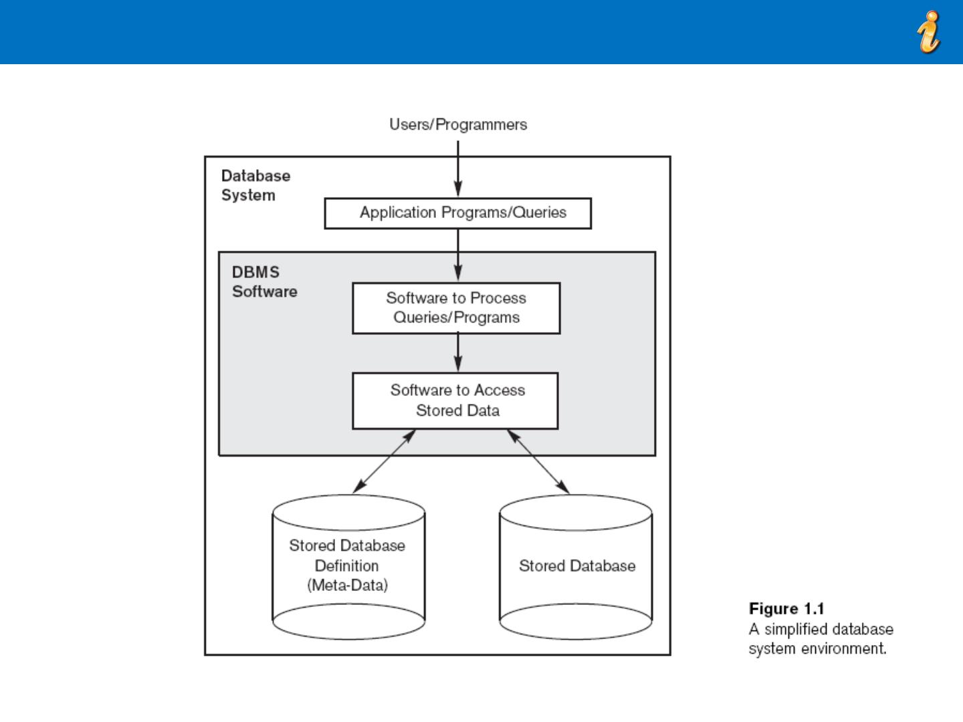
Simplified Database System Environment

Slide 16
Typical DBMS Functionality
. Define a particular database in terms of its data
types, structures, and constraints
. Construct or Load the initial database contents on a
secondary storage medium
. Manipulate the database:
» Retrieval: Querying, generating reports
» Modification: Insertions, deletions and updates to
its content
» Accessing the database through Web applications
. Processed and Shared by a set of concurrent users
and application programs – yet, keeping all data valid
and consistent

Slide 17
Additional DBMS Functionality
. DBMS may additionally provide:
» Protection or Security measures to prevent
unauthorized access
» “Active” processing to take internal actions on
data
» Presentation and Visualization of data
» Maintenance of the database and associated
programs over the lifetime of the database
application
• Called database, software, and system maintenance

Slide 18

Example of a Database (with a Conceptual Data Model)
. Mini-world for the example:
» Part of a UNIVERSITY environment.
. Some mini-world entities:
» STUDENTs
» COURSEs
» SECTIONs (of COURSEs)
» (academic) DEPARTMENTs
» INSTRUCTORs

Slide 19
Example of a Database (with a Conceptual Data Model)
. Some mini-world relationships:
» SECTIONs are of specific COURSEs
» STUDENTs take SECTIONs
» COURSEs have prerequisite COURSEs
» INSTRUCTORs teach SECTIONs
» COURSEs are offered by DEPARTMENTs
» STUDENTs major in DEPARTMENTs
. Note: The above entities and relationships are typically
expressed in a conceptual data model, such as the
ENTITY-RELATIONSHIP data model

Slide 20
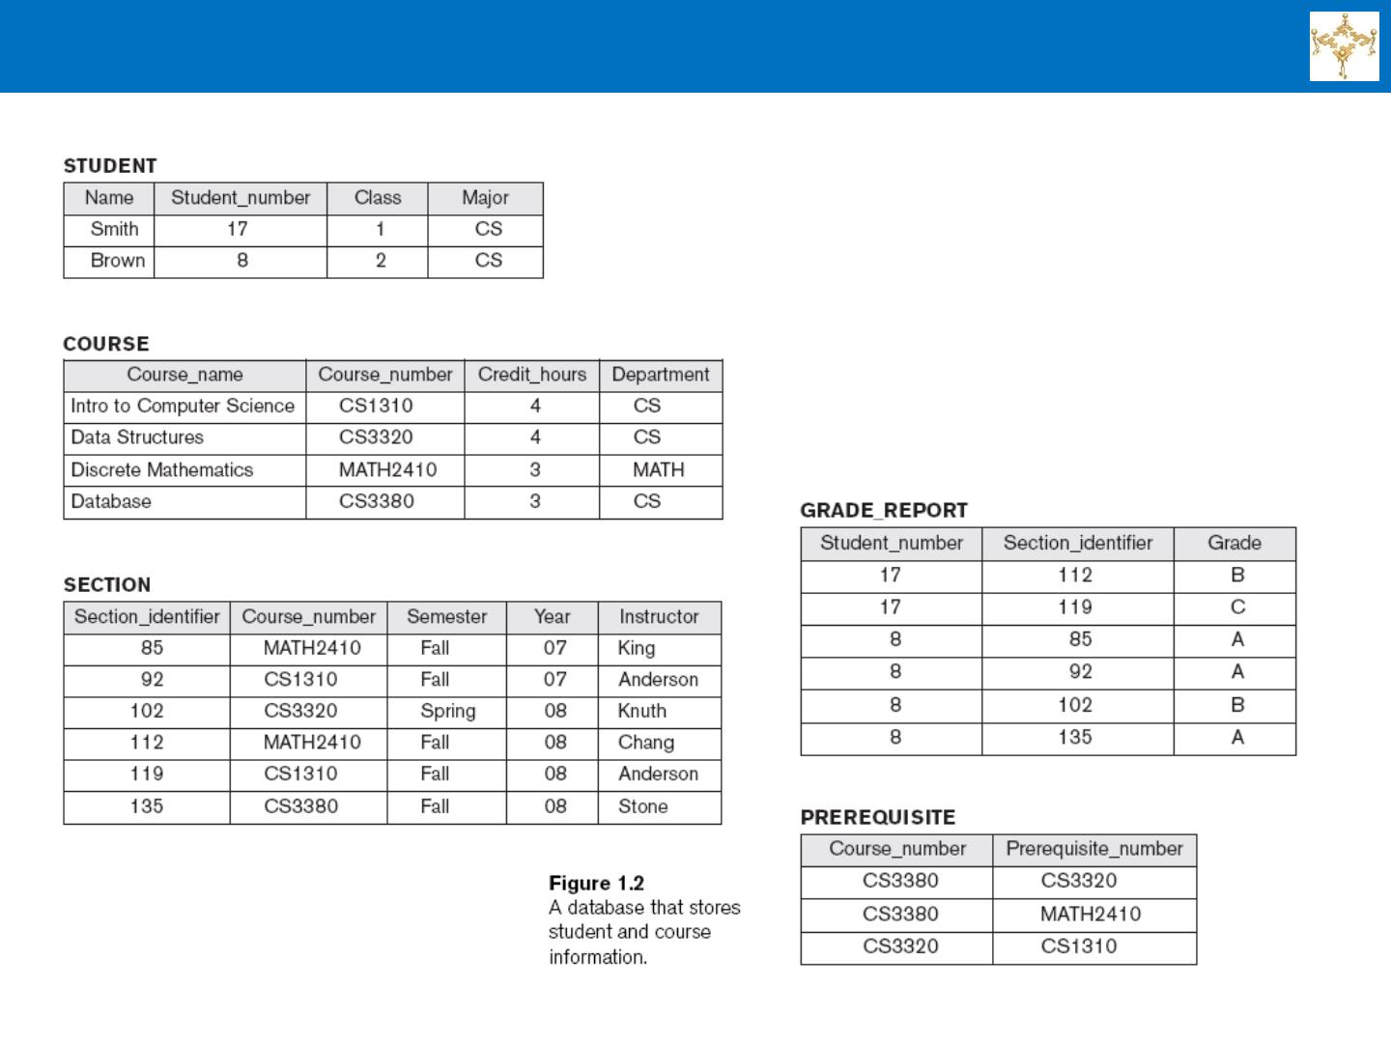
Example of a Simple Database

Slide 21
Main Characteristics of the Database Approach
. Self-describing nature of a database system:
» A DBMS catalog stores the description of a particular
database (e.g. data structures, types, and constraints)
» The description is called meta-data*.
» This allows the DBMS software to work with different
database applications.
. Insulation between programs and data:
» Called program-data independence.
» Allows changing data structures and storage organization
without having to change the DBMS access programs.
-----------------------------------------------------------------------------
* Some newer systems such as a few NOSQL systems need
no meta-data: they store the data definition within its structure
making it self describing

Slide 22
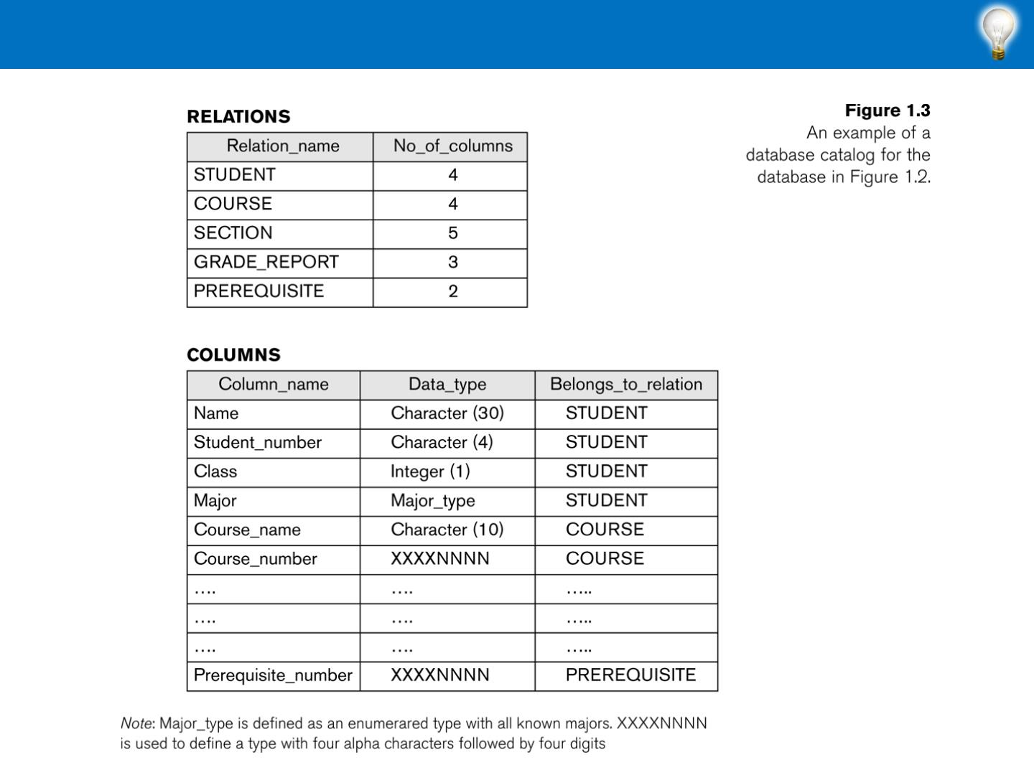
Example of a Simplified Database Catalog

Slide 23
Main Characteristics of the Database Approach (continued)
. Data Abstraction:
» A data model is used to hide storage details and
present the users with a conceptual view of the
database.
» Programs refer to the data model constructs
rather than data storage details
. Support of multiple views of the data:
» Each user may see a different view of the
database, which describes only the data of
interest to that user.

Slide 24
Main Characteristics of the Database Approach (continued)
. Sharing of data and multi-user transaction processing:
» Allowing a set of concurrent users to retrieve from and to
update the database.
» Concurrency control within the DBMS guarantees that each
transaction is correctly executed or aborted
» Recovery subsystem ensures each completed transaction has
its effect permanently recorded in the database
» OLTP (Online Transaction Processing) is a major part of
database applications. This allows hundreds of concurrent
transactions to execute per second.

Slide 25

Database Users
. Users may be divided into
» Those who actually use and control the
database content, and those who design,
develop and maintain database applications
(called “Actors on the Scene”), and
» Those who design and develop the DBMS
software and related tools, and the computer
systems operators (called “Workers Behind the
Scene”).

Slide 26
Database Users – Actors on the Scene
. Actors on the scene
» Database administrators:
• Responsible for authorizing access to the database,
for coordinating and monitoring its use, acquiring
software and hardware resources, controlling its use
and monitoring efficiency of operations.
» Database Designers:
• Responsible to define the content, the structure, the
constraints, and functions or transactions against
the database. They must communicate with the end-
users and understand their needs.

Slide 27

Database End Users
. Actors on the scene (continued)
» End-users: They use the data for queries,
reports and some of them update the database
content. End-users can be categorized into:
• Casual: access database occasionally when
needed
• Naïve or Parametric: they make up a large section
of the end-user population.
– They use previously well-defined functions in the form of
“canned transactions” against the database.
– Users of Mobile Apps mostly fall in this category
– Bank-tellers or reservation clerks are parametric users who
do this activity for an entire shift of operations.
– Social Media Users post and read information from
websites

Slide 28
Database Users – Actors on the Scene (continued)
• System Analysts and Application Developers
This category currently accounts for a very large proportion
of the IT work force.
– System Analysts: They understand the user
requirements of naïve and sophisticated users and design
applications including canned transactions to meet those
requirements.
– Application Programmers: Implement the
specifications developed by analysts and test and debug
them before deployment.
– Business Analysts: There is an increasing need for
such people who can analyze vast amounts of business
data and real-time data (“Big Data”) for better decision
making related to planning, advertising, marketing etc.

Slide 29
Database Users – Actors Behind the Scene
• System Designers and Implementors: Design and
implement DBMS packages in the form of modules and
interfaces and test and debug them. The DBMS must interface
with applications, language compilers, operating system
components, etc.
• Tool Developers: Design and implement software
systems called tools for modeling and designing databases,
performance monitoring, prototyping, test data generation,
user interface creation, simulation etc. that facilitate building of
applications and allow using database effectively.
• Operators and Maintenance Personnel: They
manage the actual running and maintenance of the database
system hardware and software environment

Slide 30
Advantages of Using the Database Approach
. Controlling redundancy in data storage and in
development and maintenance efforts.
» Sharing of data among multiple users.
. Restricting unauthorized access to data. Only the
DBA staff uses privileged commands and
facilities.
. Providing persistent storage for program Objects
» E.g., Object-oriented DBMSs make program objects
persistent
. Providing Storage Structures (e.g. indexes) for
efficient Query Processing

Slide 31
Advantages of Using the Database Approach (continued)
. Providing optimization of queries for efficient
processing.
. Providing backup and recovery services.
. Providing multiple interfaces to different classes
of users.
. Representing complex relationships among data.
. Enforcing integrity constraints on the database.
. Drawing inferences and actions from the stored
data using deductive and active rules and
triggers.

Slide 32
Summary
. Types of Databases and Database Applications
. Basic Definitions
. Typical DBMS Functionality
. Example of a Database (UNIVERSITY)
. Main Characteristics of the Database Approach
. Types of Database Users
. Advantages of Using the Database Approach

Slide 33
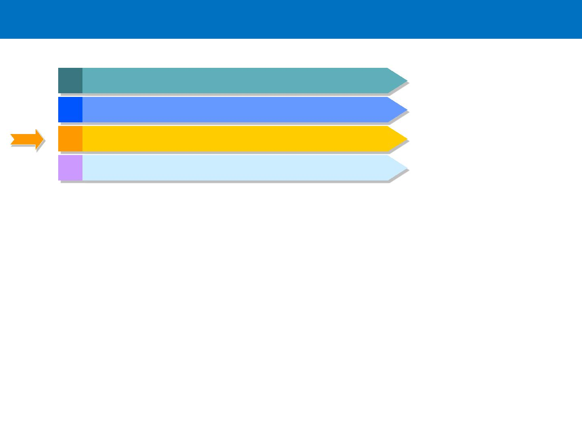
Agenda
1 Course Introduction
2 Databases and Database Users
3 Database System Concepts and Architecture
4 Summary and Conclusion

Slide 34
Section Outline
. Data Models and Their Categories
. Schemas, Instances, and States
. Three-Schema Architecture
. Data Independence
. DBMS Languages and Interfaces
. Database System Environment
. Centralized and Client-Server Architectures
. Classification of DBMSs

Slide 35
Data Models
. Data Model:
» A set of concepts to describe the structure of a database, the
operations for manipulating these structures, and certain
constraints that the database should obey.
. Data Model Structure and Constraints:
» Constructs are used to define the database structure
» Constructs typically include elements (and their data types) as
well as groups of elements (e.g. entity, record, table), and
relationships among such groups
» Constraints specify some restrictions on valid data; these
constraints must be enforced at all times
. Data Model Operations:
» These operations are used for specifying database retrievals and updates
by referring to the constructs of the data model.
» Operations on the data model may include basic model operations (e.g.
generic insert, delete, update) and user-defined operations (e.g.
compute_student_gpa, update_inventory)

Slide 36
Categories of Data Models
. Conceptual (high-level, semantic) data models:
» Provide concepts that are close to the way many users
perceive data.
• (Also called entity-based or object-based data models.)
. Physical (low-level, internal) data models:
» Provide concepts that describe details of how data is stored
in the computer. These are usually specified in an ad-hoc
manner through DBMS design and administration manuals
. Implementation (representational) data models:
» Provide concepts that fall between the above two, used by
many commercial DBMS implementations (e.g. relational
data models used in many commercial systems).
. Self-Describing Data Models:
» Combine the description of data with the data values.
Examples include XML, key-value stores and some NOSQL
systems.

Slide 37
Schemas vs. Instances
. Database Schema:
» The description of a database.
» Includes descriptions of the database structure, data types, and
the constraints on the database.
. Schema Diagram:
» An illustrative display of (most aspects of) a database schema.
. Schema Construct:
» A component of the schema or an object within the schema, e.g.,
STUDENT, COURSE.
. Database State:
» The actual data stored in a database at a particular moment in
time. This includes the collection of all the data in the database.
» Also called database instance (or occurrence or snapshot).
• The term instance is also applied to individual database components,
e.g. record instance, table instance, entity instance

Slide 38
Database Schema vs. Database State
. Database State:
» Refers to the content of a database at a moment in time.
. Initial Database State:
» Refers to the database state when it is initially loaded into the
system.
. Valid State:
» A state that satisfies the structure and constraints of the database
. Distinction
» The database schema changes very infrequently.
» The database state changes every time the database is updated.
. Schema is also called intension.
. State is also called extension.

Slide 39
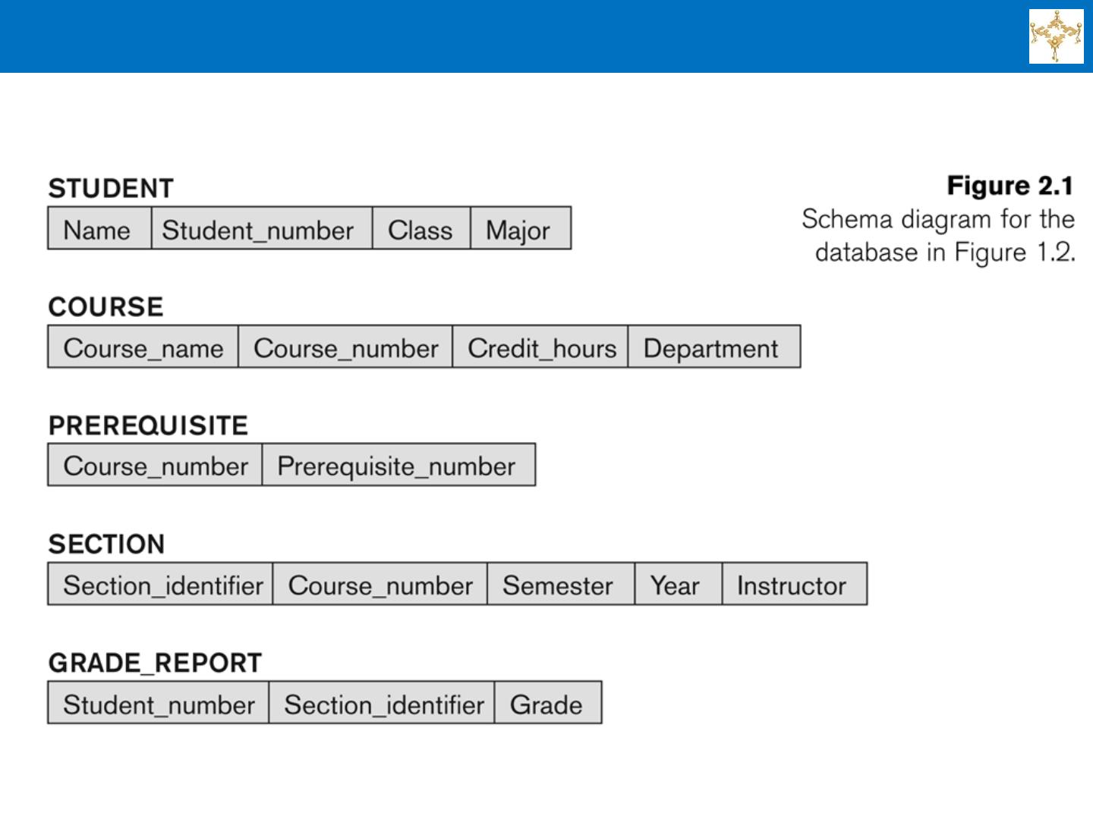
Example of a Database Schema

Slide 40
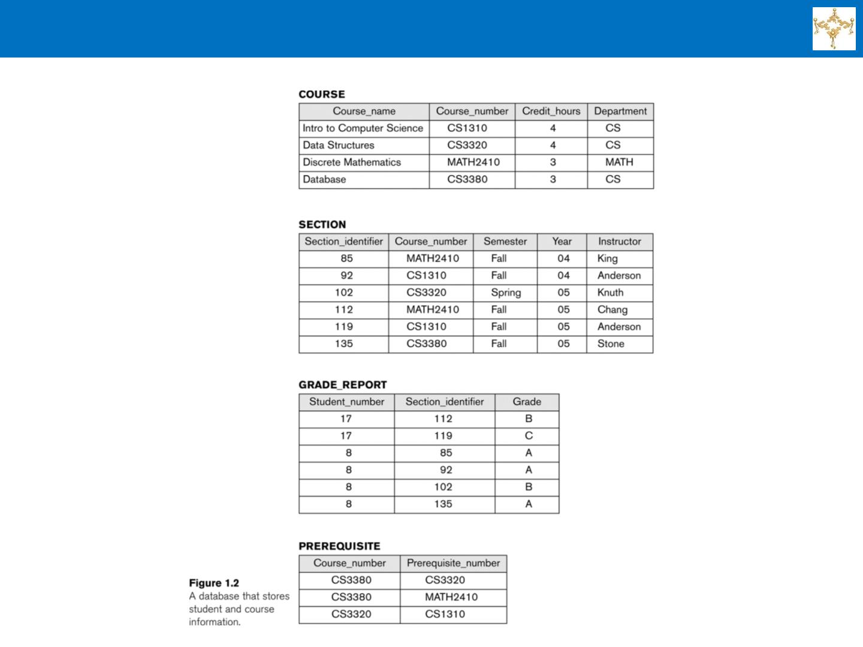
Example of a Database State

Slide 41
Three-Schema Architecture
. Proposed to support DBMS characteristics of:
» Program-data independence.
» Support of multiple views of the data.
. Not explicitly used in commercial DBMS products, but has
been useful in explaining database system organization
. Defines DBMS schemas at three levels:
» Internal schema at the internal level to describe physical storage
structures and access paths (e.g indexes).
• Typically uses a physical data model.
» Conceptual schema at the conceptual level to describe the structure and
constraints for the whole database for a community of users.
• Uses a conceptual or an implementation data model.
» External schemas at the external level to describe the various user
views.
• Usually uses the same data model as the conceptual schema.

Slide 42
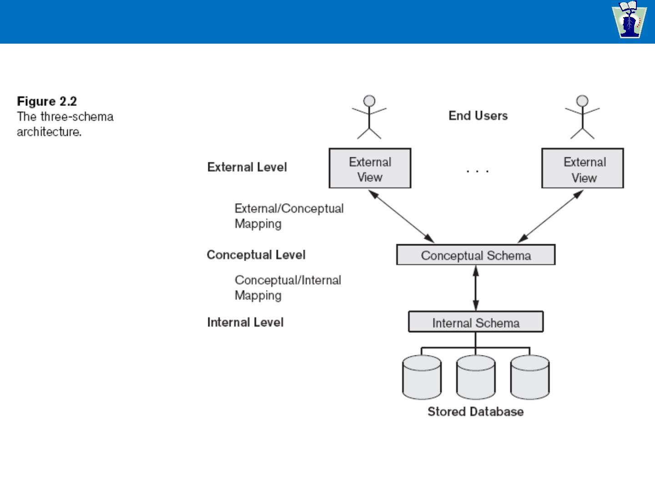
The Three-Schema Architecture

Slide 43
Three-Schema Architecture
. Mappings among schema levels are
needed to transform requests and data.
» Programs refer to an external schema, and are
mapped by the DBMS to the internal schema
for execution.
» Data extracted from the internal DBMS level is
reformatted to match the user’s external view
(e.g. formatting the results of an SQL query for
display in a Web page)

Slide 44
Data Independence
. Logical Data Independence:
» The capacity to change the conceptual schema without having to change
the external schemas and their associated application programs.
. Physical Data Independence:
» The capacity to change the internal schema without having to change the
conceptual schema.
» For example, the internal schema may be changed when certain file
structures are reorganized or new indexes are created to improve
database performance
. When a schema at a lower level is changed, only the mappings
between this schema and higher-level schemas need to be changed
in a DBMS that fully supports data independence.
. The higher-level schemas themselves are unchanged.
» Hence, the application programs need not be changed since they refer to
the external schemas.

Slide 45
DBMS Languages
. Data Definition Language (DDL)
» Used by the DBA and database designers to specify the
conceptual schema of a database.
» In many DBMSs, the DDL is also used to define internal and
external schemas (views).
» In some DBMSs, separate storage definition language (SDL)
and view definition language (VDL) are used to define internal
and external schemas.
• SDL is typically realized via DBMS commands provided to the DBA
and database designers

Slide 46
DBMS Languages (continued)
. Data Manipulation Language (DML)
» High-Level or Non-procedural Languages: These include the
relational language SQL
• May be used in a standalone way or may be embedded in a
programming language
» Low Level or Procedural Languages:
• These must be embedded in a programming language
» Used to specify database retrievals and updates
» DML commands (data sublanguage) can be embedded in a
general-purpose programming language (host language), such as
COBOL, C,
C++, or Java.
• A library of functions can also be provided to access the DBMS from a
programming language
» Alternatively, stand-alone DML commands can be applied directly
(called a query language).

Slide 47
Types of DML
. High Level or Non-procedural Language:
» For example, the SQL relational language
» Are “set”-oriented and specify what data to
retrieve rather than how to retrieve it.
» Also called declarative languages.
. Low Level or Procedural Language:
» Retrieve data one record-at-a-time;
» Constructs such as looping are needed to
retrieve multiple records, along with positioning
pointers.

Slide 48
DBMS Interfaces
. Stand-alone query language interfaces
» Example: Entering SQL queries at the DBMS
interactive SQL interface (e.g. SQL*Plus in ORACLE)
. Programmer interfaces for embedding DML in
programming languages
. User-friendly interfaces
» Menu-based, forms-based, graphics-based, etc.
. Mobile Interfaces are interfaces allowing users to
perform transactions using mobile apps

Slide 49
DBMS Programming Language Interfaces
. Programmer interfaces for embedding DML
in a programming languages:
» Embedded Approach: e.g. embedded SQL (for C, C++, etc.),
SQLJ (for Java)
» Procedure Call Approach: e.g. JDBC for Java, ODBC (Open
Databse Connectivity) for other programming languages as API’s
(application programming interfaces)
» Database Programming Language Approach: e.g. ORACLE
has PL/SQL, a programming language based on SQL; language
incorporates SQL and its data types as integral components
» Scripting Languages: PHP (client-side scripting) and Python
(server-side scripting) are used to write database programs.

Slide 50
User-Friendly DBMS Interfaces
» Menu-based (Web-based), popular for
browsing on the web
» Forms-based, designed for naïve users used to
filling in entries on a form
» Graphics-based
• Point and Click, Drag and Drop, etc.
• Specifying a query on a schema diagram
» Natural language: requests in written English
» Combinations of the above:
• For example, both menus and forms used
extensively in Web database interfaces.

Slide 51
Other DBMS Interfaces
» Natural language: free text as a query
» Speech : Input query and Output response
» Web Browser with keyword search
» Parametric interfaces, e.g., bank tellers using
function keys.
» Interfaces for the DBA:
• Creating user accounts, granting authorizations
• Setting system parameters
• Changing schemas or access paths

Slide 52
The Database System Environment
. DBMS component modules
. Buffer management
. Stored data manager
. DDL compiler
. Interactive query interface
• Query compiler
• Query optimizer
. Pre-compiler
. Runtime database processor
. System catalog
. Concurrency control system
. Backup and recovery system

Slide 53
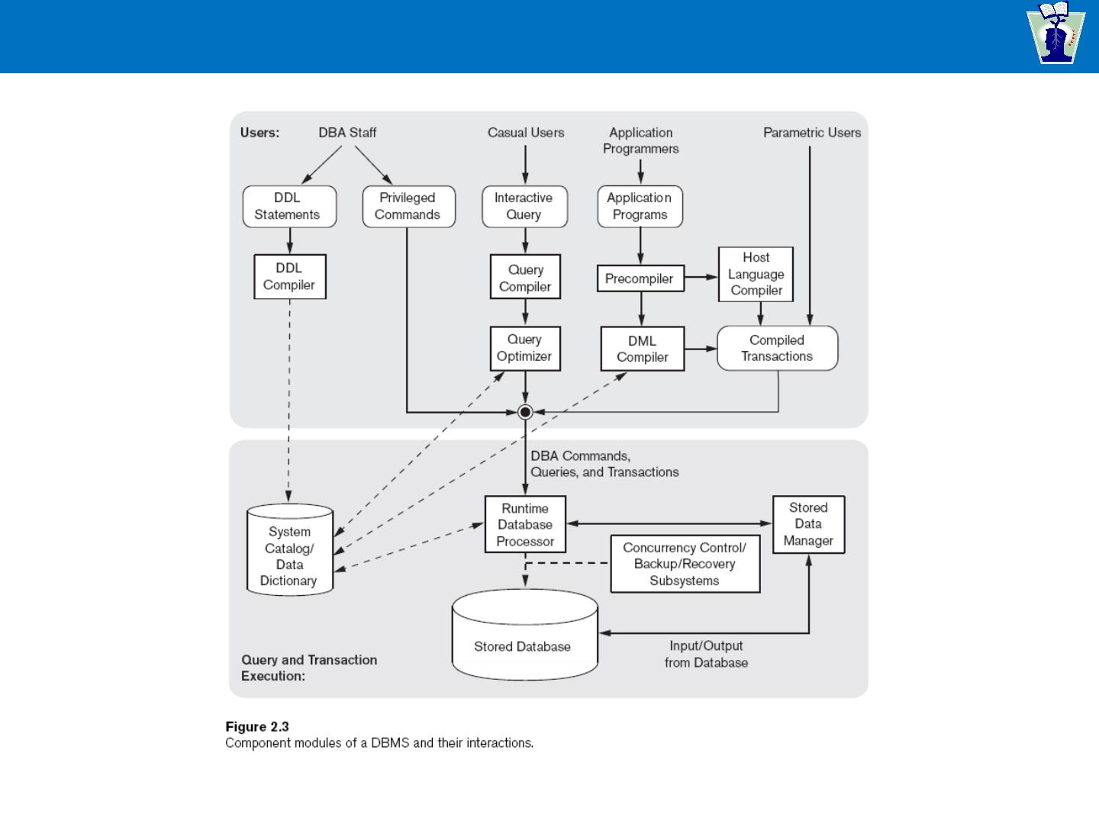
Typical DBMS Component Modules

Slide 54
Centralized and Client-Server DBMS Architectures
. Centralized DBMS:
» Combines everything into single system
including- DBMS software, hardware,
application programs, and user interface
processing software.
» User can still connect through a remote
terminal – however, all processing is done at
centralized site.

Slide 55
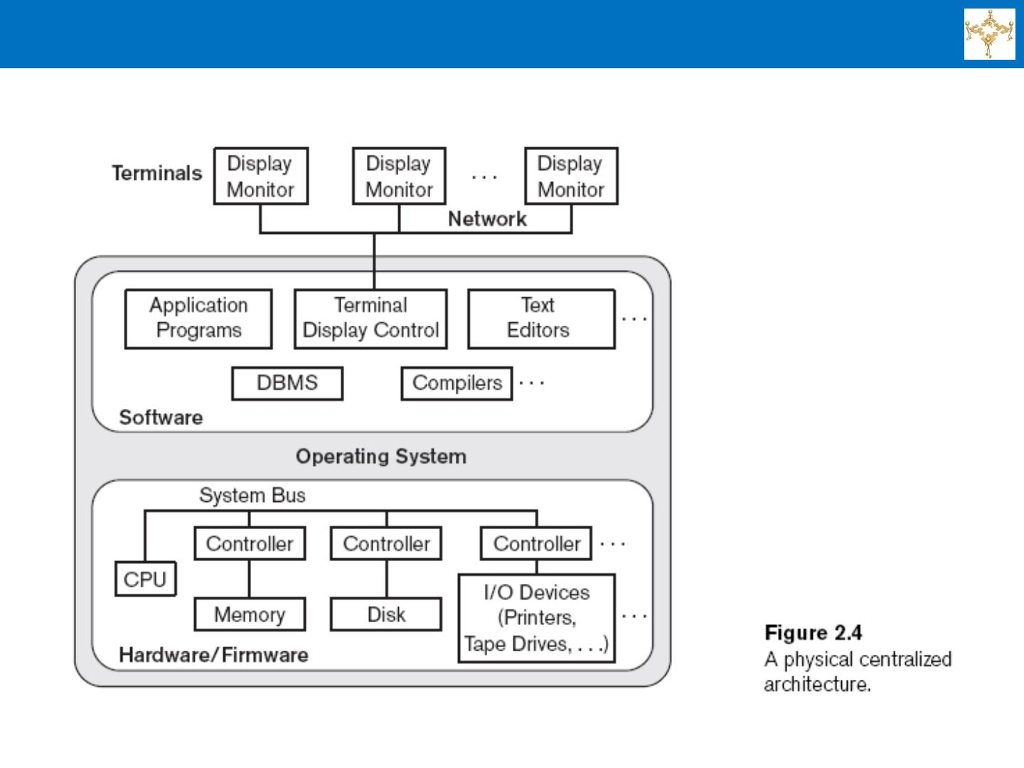
A Physical Centralized DBMS Architecture

Slide 56
Basic 2-tier Client / Server Architectures
. Specialized Servers with Specialized
functions
» Print server
» File server
» DBMS server
» Web server
» Email server
. Clients can access the specialized servers
as needed

Slide 57
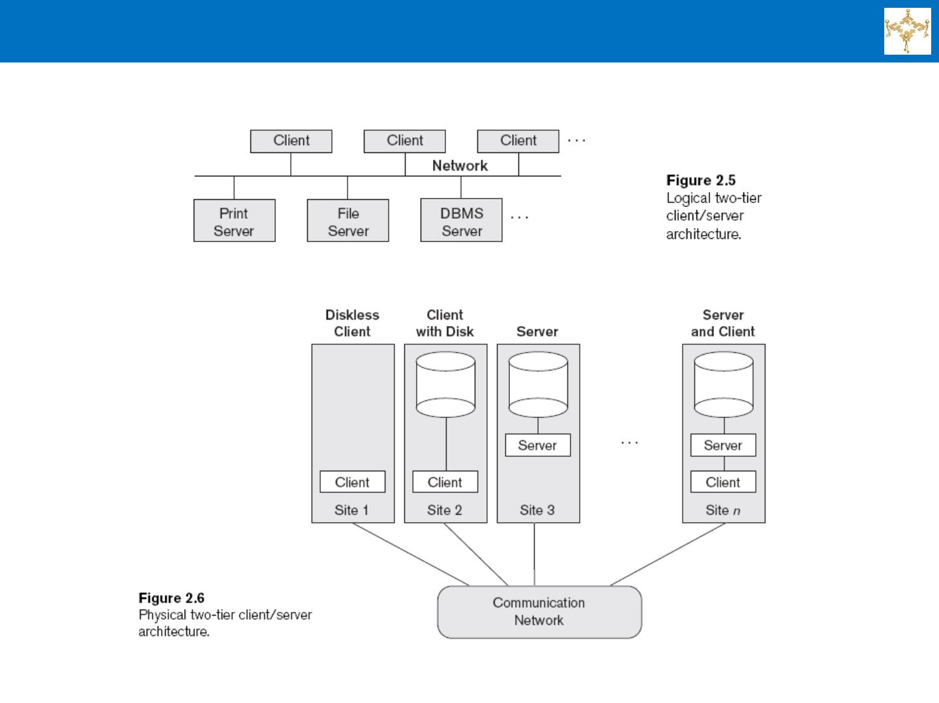
Logical and Physical Two-Tier Client / Server Architecture

Slide 58
DBMS Clients
. Provide appropriate interfaces through a
client software module to access and utilize
the various server resources.
. Clients may be diskless machines or PCs
or Workstations with disks with only the
client software installed.
. Connected to the servers via some form of
a network.
» (LAN: local area network, wireless network,
etc.)

Slide 59
DBMS Server
. Provides database query and transaction services to the
clients
. Relational DBMS servers are often called SQL servers,
query servers, or transaction servers
. Applications running on clients utilize an Application
Program Interface (API) to access server databases via
standard interface such as:
» ODBC: Open Database Connectivity standard
» JDBC: for Java programming access

Slide 60
Two Tier Client-Server Architecture
. Client and server must install appropriate client module
and server module software for ODBC or JDBC
. A client program may connect to several DBMSs,
sometimes called the data sources.
. In general, data sources can be files or other non-DBMS
software that manages data.

Slide 61
Three Tier Client-Server Architecture
. Common for Web applications
. Intermediate Layer called Application Server or Web
Server:
» Stores the web connectivity software and the business logic
part of the application used to access the corresponding
data from the database server
» Acts like a conduit for sending partially processed data
between the database server and the client.
. Three-tier Architecture Can Enhance Security:
» Database server only accessible via middle tier
» Clients cannot directly access database server
» Clients contain user interfaces and Web browsers
» The client is typically a PC or a mobile device connected to
the Web

Slide 62
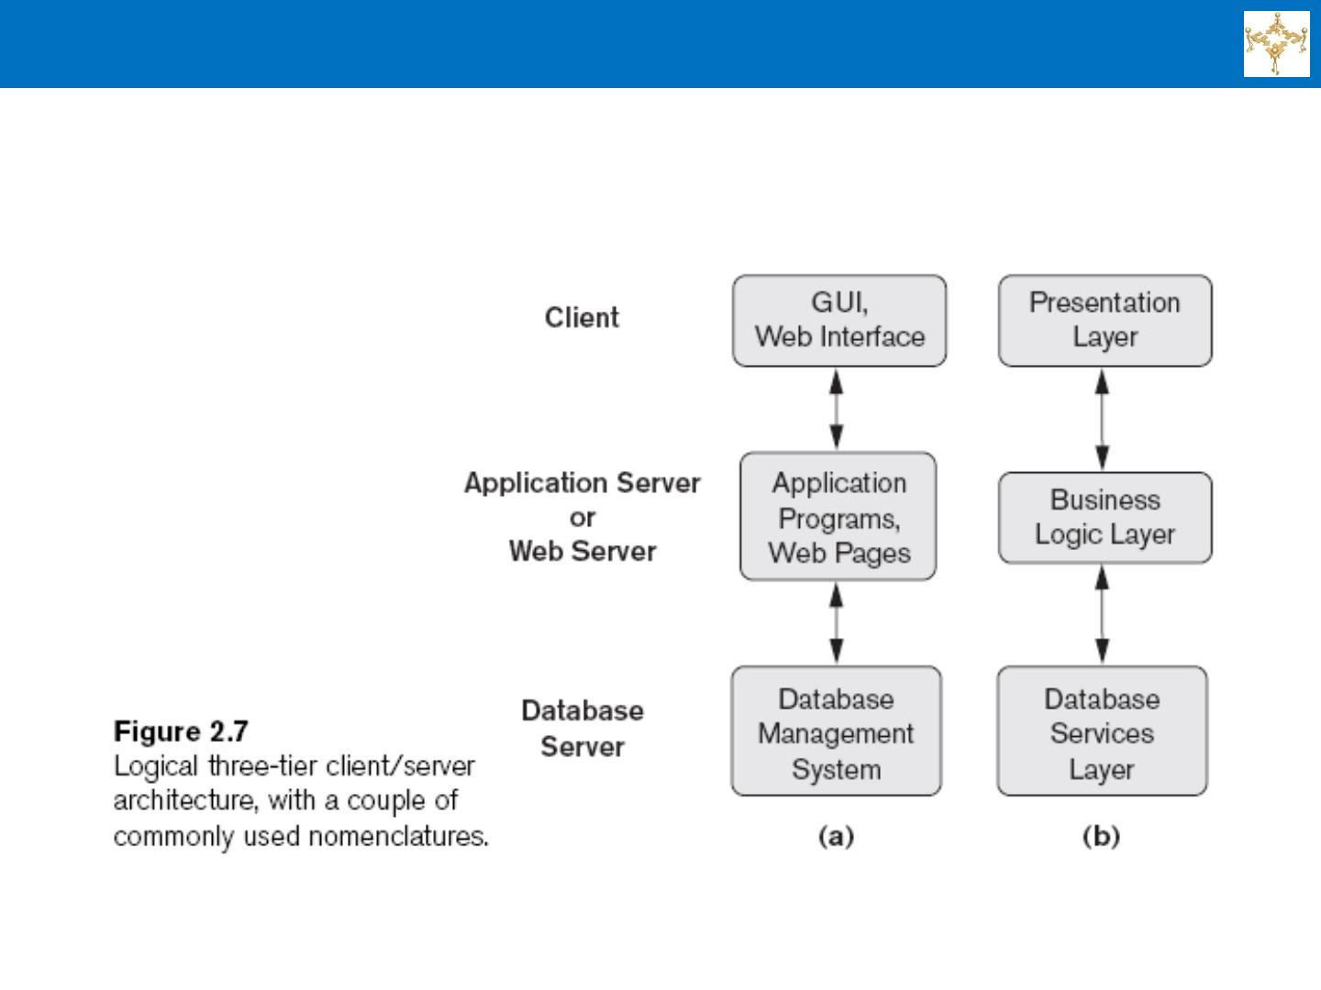
Three-Tier Client/Server Architecture

Slide 63
Classification of Database Management Systems
. Based on the data model used
» Legacy: Network, Hierarchical.
» Currently Used: Relational, Object-oriented, Object-
relational
» Recent Technologies: Key-value storage systems,
NOSQL systems: document based, column-based,
graph-based and key-value based. Native XML
DBMSs.
. Other classifications
» Single-user (typically used with personal computers)
vs. multi-user (most DBMSs).
» Centralized (uses a single computer with one
database) vs. distributed (multiple computers, multiple
DBs)

Slide 64
Section Summary
. Data Models and Their Categories
. Schemas, Instances, and States
. Three-Schema Architecture
. Data Independence
. DBMS Languages and Interfaces
. Database System Environment
. Centralized and Client-Server Architectures
. Classification of DBMSs
93

Slide 65
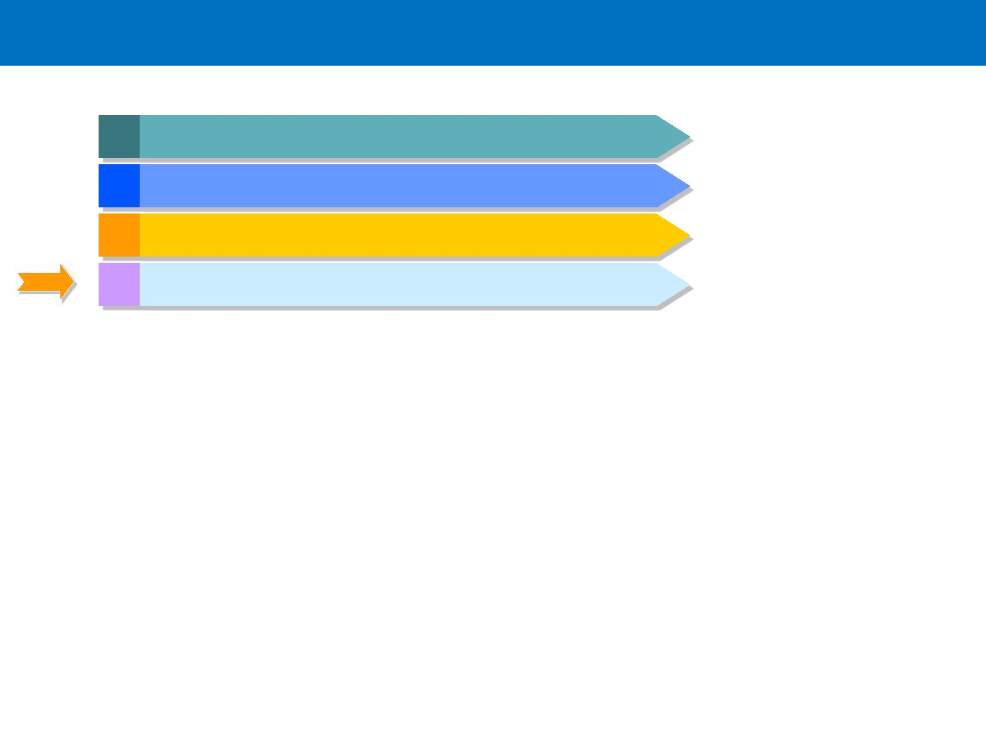
Agenda
1 Course Introduction
2 Databases and Database Users
3 Database System Concepts and Architecture
4 Summary and Conclusion

Slide 66
Course Assignments
■
Individual Assignments
■
Reports based on case studies / class presentations
Textbook problem sets
■
■
Project-Related Assignments
■
All assignments (other than the individual assessments) will
correspond to milestones in the course project

Slide 67

Assignments & Readings
. Readings
» Lecture notes and Handouts posted on the course net disk
» Textbook: Chapters 1 & 2 of both textbooks
Assignment 1:
Exercise in Ch1 of the Text Book B as Review (No need to submit)
Notes:
tes

